Slide 1
Secure Data Hiding in Image Using Steganography
CAPSTONE PROJECT
Presented By:
Student Name : Bhaskar Jyoti Kaushik
College Name & Department : Jorhat Engineering College / Computer Science & Engineering

Slide 2
OUTLINE
Problem Statement
Technology used
Wow factor
End users
Result
Conclusion
Git-hub Link
Future scope

Slide 3
Problem Statement
Traditional communication methods are susceptible to interception and monitoring. When sensitive information needs to be shared, users require a secure method that doesn't draw attention. Standard encryption often raises suspicion by its very presence, so a more covert approach is needed.

Slide 4
Technology used
Python programming language
OpenCV (Computer Vision library) for image processing
Tkinter for building intuitive graphical user interfaces
PIL (Python Imaging Library) for image handling and manipulation
Steganography techniques to embed data within pixels of images

Slide 5
Wow factors
What makes this project stand oImage-
Image Based Encryption – Securely hides secret messages inside images using pixel manipulation.
Password-Protected Encryption – Ensures data security by requiring a passcode for decryption.
User-Friendly GUI – Interactive interface using Tkinter for ease of use.
Standalone Application – No external dependencies; can be run on any system with Python and required libraries.

Slide 6
End users
Privacy-conscious individuals who want to communicate securely
Journalists protecting confidential sources
Business professionals sharing sensitive company information
Anyone needing to transmit confidential data in plain sight

Slide 7
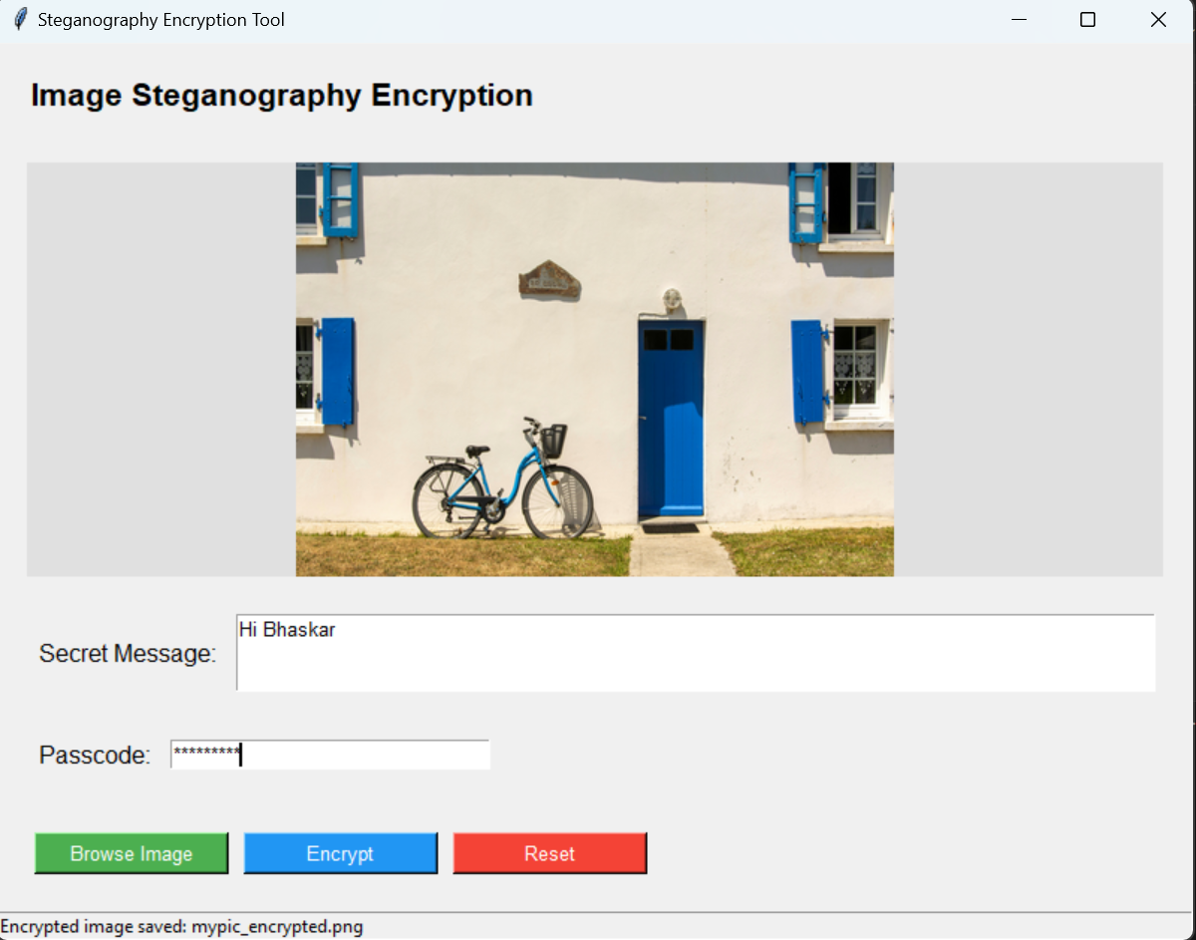
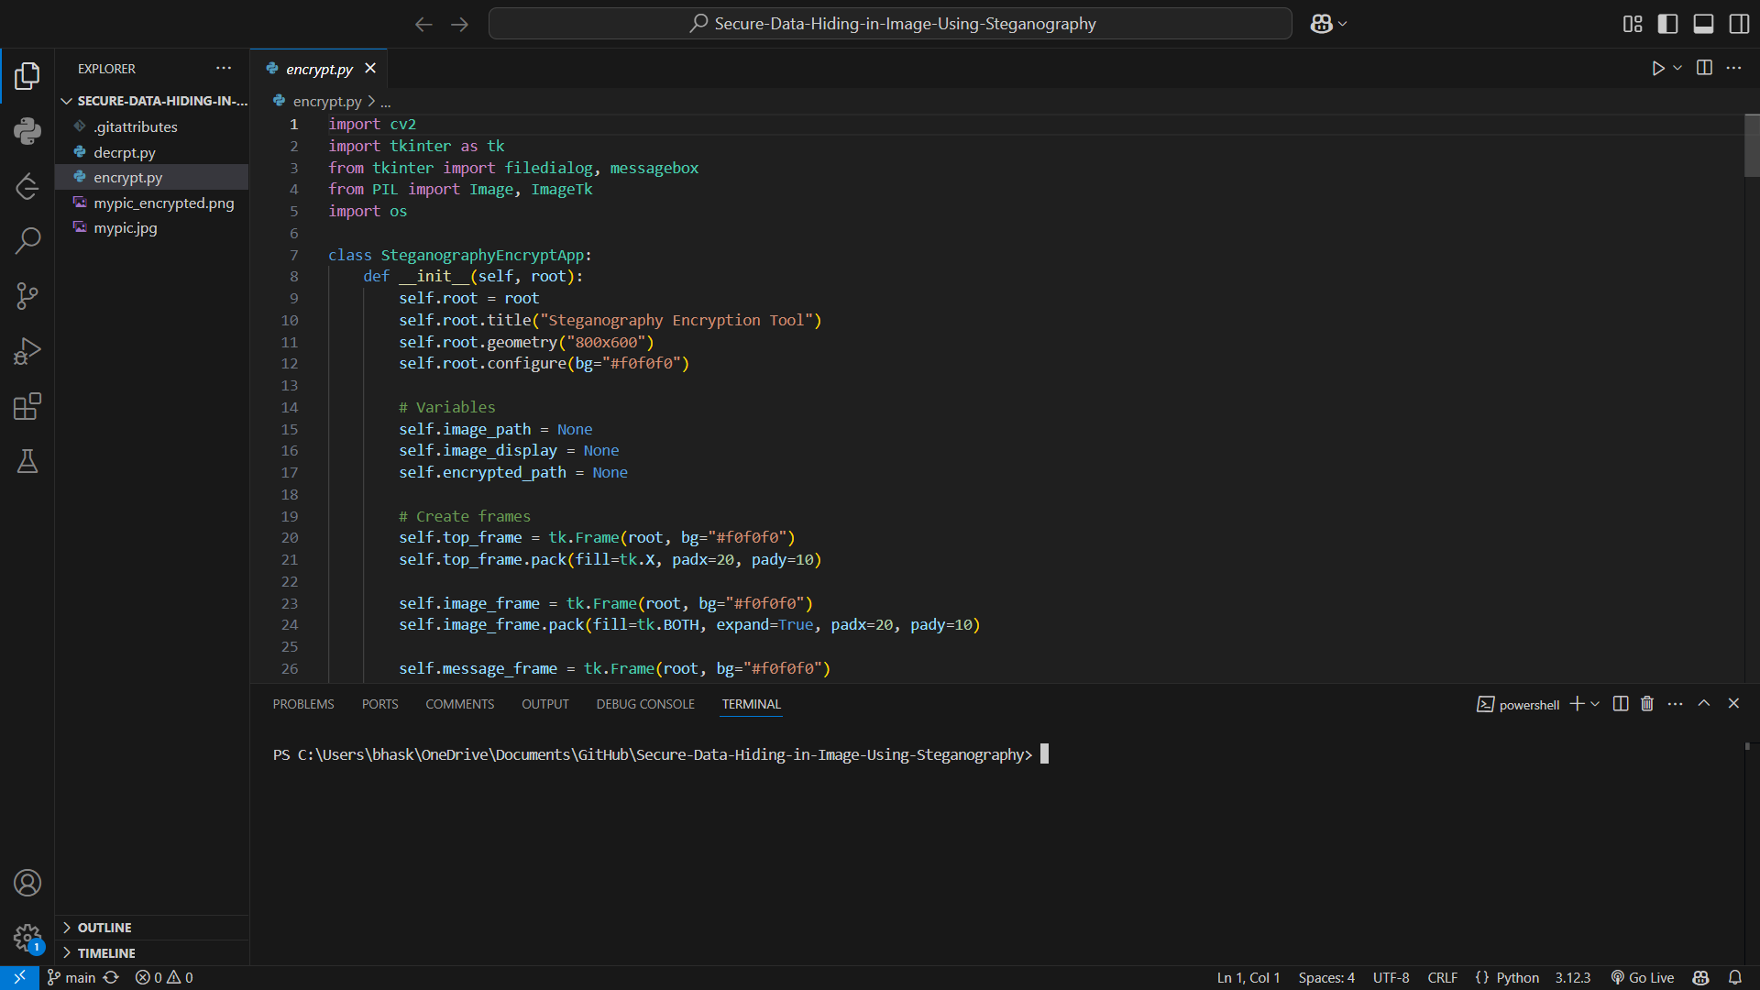
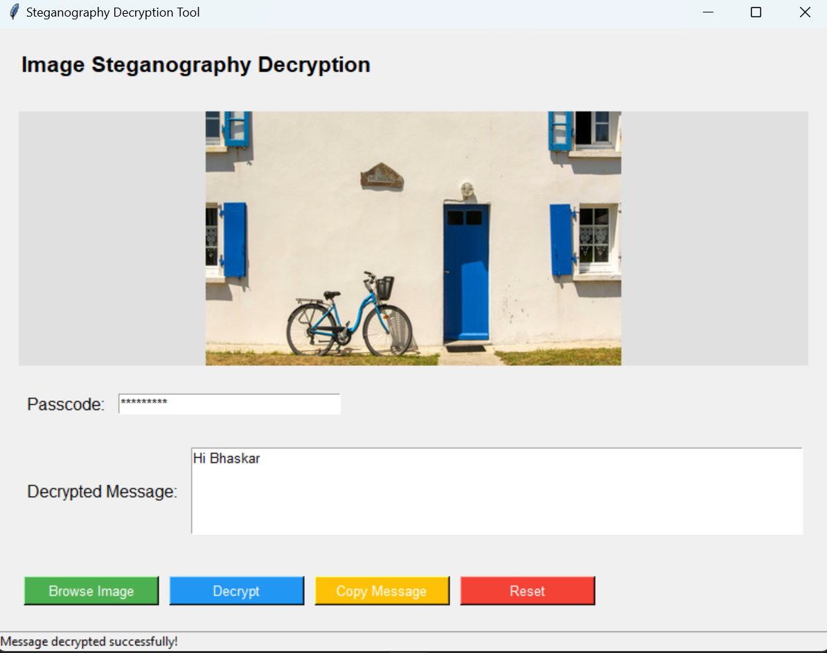
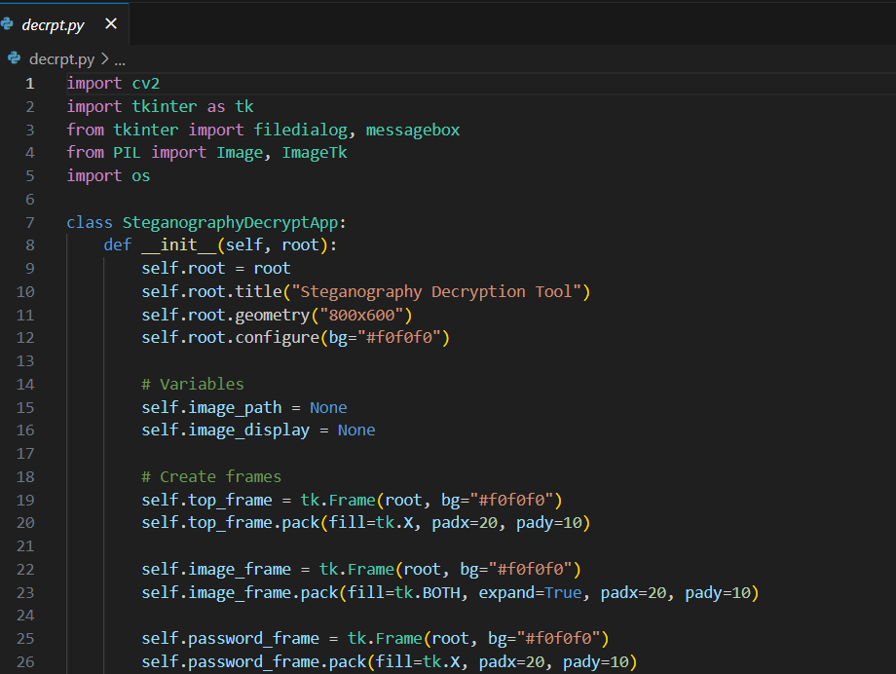
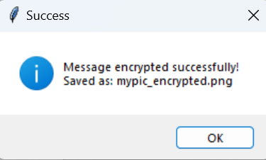
Results

Slide 8
Conclusion
Enhanced Data Security – The project successfully implements image-based encryption, ensuring secure
message concealment with password protection.
User-Friendly Interface – The intuitive GUI makes encryption accessible to users without technical expertise.
Efficient and Reliable – The tool optimizes image space for message embedding while maintaining image
quality.
Potential for Expansion – Future improvements can include decryption features, advanced encryption
techniques, and support for larger file sizes.

Slide 9
GitHub Link
https://github.com/BHASKARJYOTIKAUSHIK/Secure-Data-Hiding-in-Image-Using-Steganography

Slide 10
Future scope(optional)
Advanced Encryption Algorithms – Implement stronger cryptographic techniques like AES or RSA for enhanced security.
Audio & Video Steganography – Extend the tool to hide messages in audio and video files for broader applications.
Cloud Integration – Enable secure online storage and retrieval of steganographic images.
Mobile App Development – Develop an Android/iOS version for on-the-go encryption and decryption.

Slide 11
THANK YOU

